Slide 1

Azure Static Web Apps

Slide 2

About me
Michael Hanft
Senior Web Developer bei white duck
Email: Michael.hanft@whiteduck.de

Slide 3
Azure Static Web Apps
Web hosting
Integrated API
First-party GitHub integration
Globally distributed
Custom domains
Authentication provider integrations
Customizable authorization role definition
Generated staging versions

Slide 4
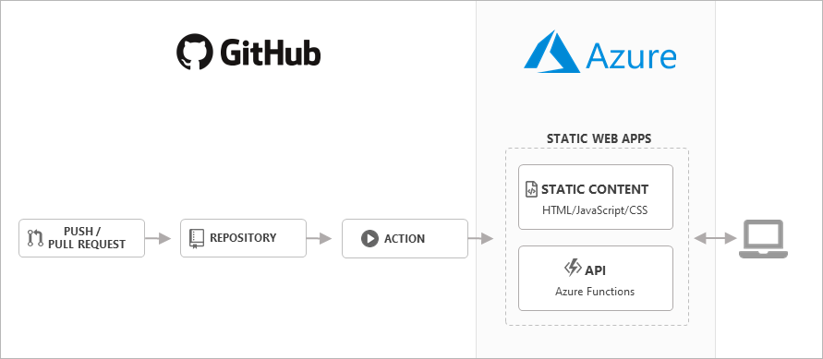

Slide 5
DEMO

